Slide 1
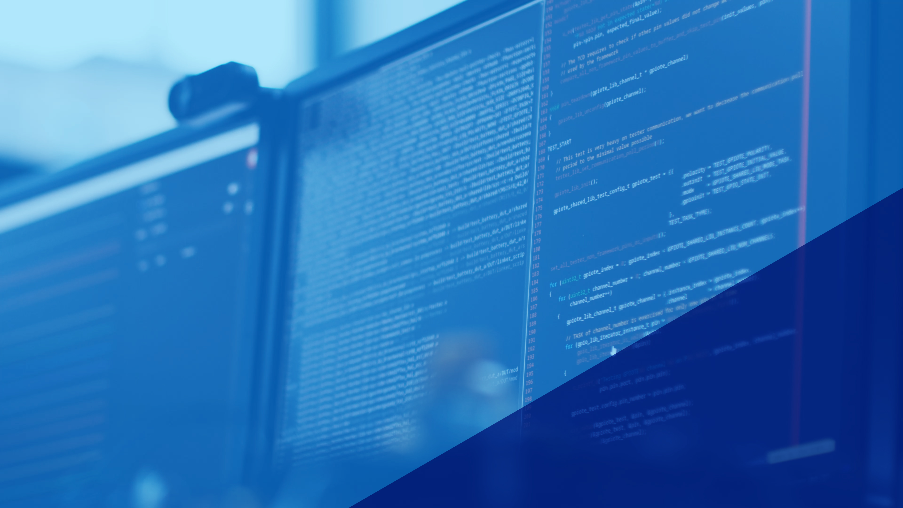
nRF Connect SDK and tools
Next generation SDK for Nordic wireless solutions, and it’s tools and development environment
H2, 2022
Nordic Tech Tour 2022

Slide 2

nRF Connect
nRF Connect is our umbrella of tools to help developers build and debug their applications quickly
Consist of
nRF Connect SDK
nRF Connect for Desktop
nRF Connect for VS Code
nRF Cloud
Mobile applications

Slide 3
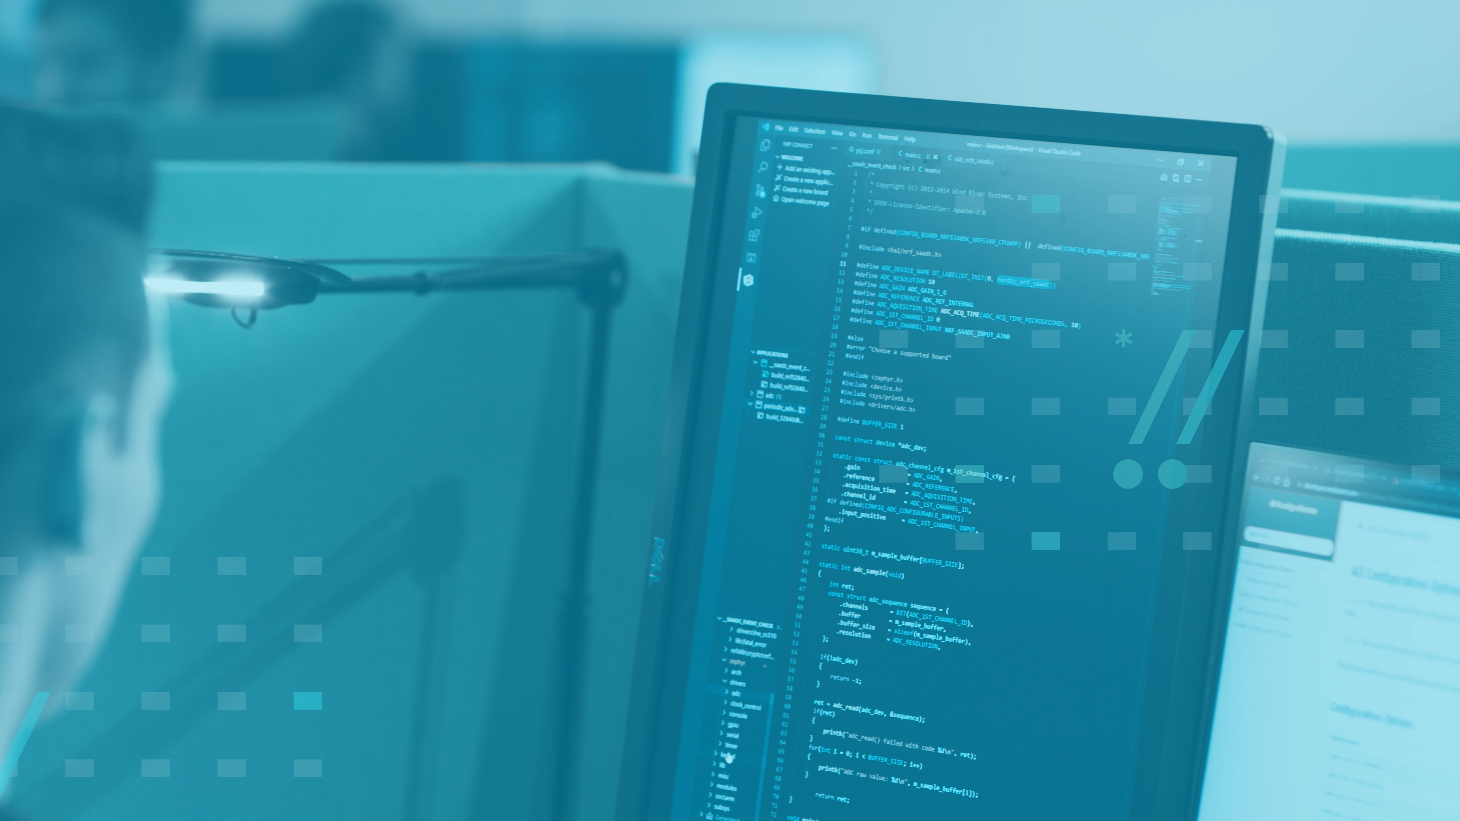
nRF Connect SDK
Introduction

Slide 4
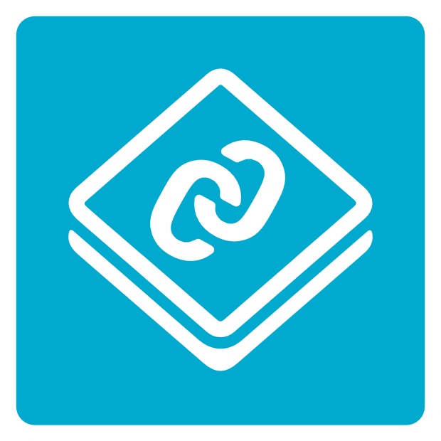


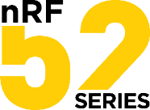

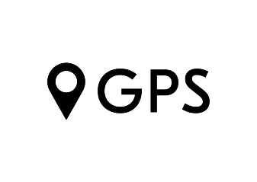



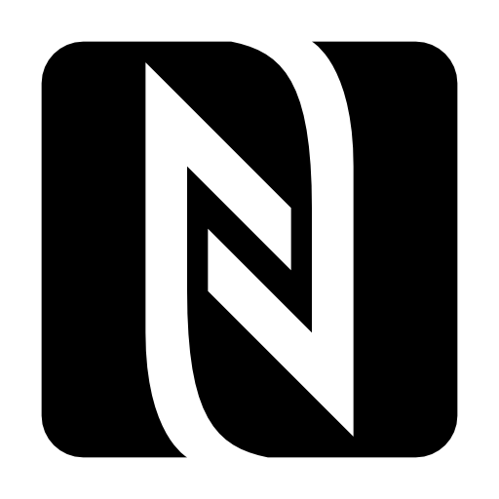
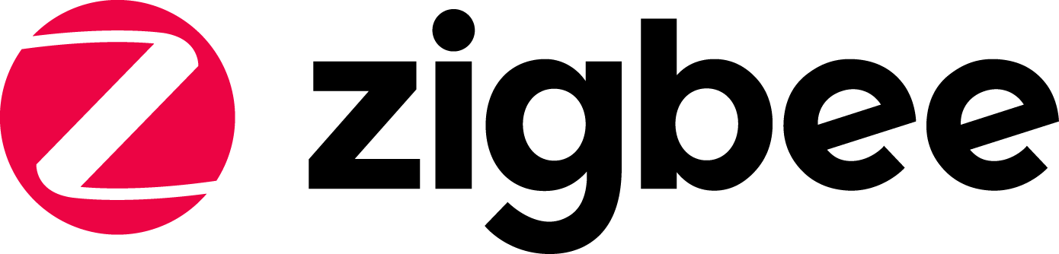
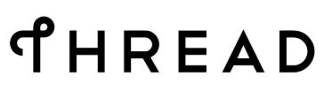
nRF Connect SDK
One code base and toolchain for nRF91, nRF53, nRF52 and nRF21 Series
Optional for nRF52 Series ( >= v1.3.0)
Includes LTE-M/NB-IoT/GPS, Bluetooth Low Energy, Bluetooth mesh, Thread/Zigbee, Matter, ESB, Gazell, NFC
Bluetooth v5.3 qualified Host and Controller stack since v2.0.0
Notes:
Dev support for 52 Series in v1.3.0 tag
Bluetooth Host is now Bluetooth Core Specification v5.1 qualified after NCS v1.3.1
SoftDevice controller (in sdk-nrfxlib) is now Bluetooth Core Specification v5.2 qualified.

Slide 5
Code base
Contains app code, connectivity protocols, wireless stacks and peripheral drivers
Code is organized into several repositories (Nordic - blue and Open Source (OS) code - purple)
Samples & Demos
Applications
Nordic Applications
DFU
Connectivity Protocols, Security Libraries, DFU
Secure Partition Manager
Thread Integration
Zigbee
Middleware
west.yml
COAP
MQTT
Crypto APIs
TLS/DTLS
MCU Bootloader
UDP
TCP
Driver APIs
IPv4
IPv6
File systems
BLE Mesh
BLE Host
Wireless Stacks, Multiprotocol & Device Drivers
Zephyr RTOS
802.15.4
BLE LL
Multiprotocol / coex
LTE Lx
Board Configuration
*.dtsi
Board & Device config
PHY interfaces
Notes:
Blue is Nordic SW, purple is Zephyr SW, board configurations contain some open source SW such as dtsi (device tree)
Why do we have 4 repositories, clean way of code separation, changes to the Zephyr project repo do not affect the Nordic Zephyr repo
nrfxlib contains RTOS independent libraries and modules (BSDLib, Crypto, NFC)
Figure
Connectivity includes things like protocols (Thread, Zigbee)
Middleware could be a customer’s custom code, Bluetooth Host layers, TLS, UDP, TCP, bootloader, power management, etc.
Wireless stacks includes the LTE Layers 1, 2 and 3, Bluetooth LE Link Layer
SoftDevice Controller (LL plus PHY) has been ported over to NCS
Ensures same best in class SoftDevice performance on Bluetooth LE also available in NCS
Board configuration includes items such as radio PHY layer, different board specific files for setting up GPIO mapping (dts), etc.

Slide 6
nRF Connect SDK repositories
nRF: Application & connectivity protocols
nrfxlib: compiled libraries where Nordic cannot distribute source code
nrfx: peripheral drivers
Zephyr: RTOS & board configuration (OS)
MCUboot: Secure Bootloader (OS)
Other repositories
Trusted Firmware-M, Matter, etc.
Samples & Demos
Applications
Nordic Applications
DFU
Connectivity Protocols, Security Libraries, DFU
Secure Partition Manager
Thread Integration
Zigbee
Middleware
west.yml
COAP
MQTT
Crypto APIs
TLS/DTLS
MCU Bootloader
UDP
TCP
Driver APIs
IPv4
IPv6
File systems
BLE Mesh
BLE Host
Wireless Stacks, Multiprotocol & Device Drivers
Zephyr RTOS
802.15.4
BLE LL
Multiprotocol / coex
LTE Lx
Board Configuration
*.dtsi
Board & Device config
PHY interfaces
Notes:
Blue is Nordic SW, purple is Zephyr SW, board configurations contain some open source SW such as dtsi (device tree)
Why do we have 4 repositories, clean way of code separation, changes to the Zephyr project repo do not affect the Nordic Zephyr repo
nrfxlib contains RTOS independent libraries and modules (BSDLib, Crypto, NFC)
Figure
Connectivity includes things like protocols (Thread, Zigbee)
Middleware could be a customer’s custom code, Bluetooth Host layers, TLS, UDP, TCP, bootloader, power management, etc.
Wireless stacks includes the LTE Layers 1, 2 and 3, Bluetooth LE Link Layer
SoftDevice Controller (LL plus PHY) has been ported over to NCS
Ensures same best in class SoftDevice performance on Bluetooth LE also available in NCS
Board configuration includes items such as radio PHY layer, different board specific files for setting up GPIO mapping (dts), etc.

Slide 7

Code base in detail
Samples & Demos
Applications
A wide range of wireless technologies and applications is supported by one integrated code base
Code management, build and configuration tools allow developers to focus on the components required for their specific designs while having a powerful solution toolbox available
DFU
Secure Partition Manager
Thread
Zigbee
west.yml
COAP
MQTT
Crypto APIs
TLS/DTLS
MCU Bootloader
UDP
TCP
Driver APIs
IPv4
IPv6
File systems
Bluetooth mesh models
Bluetooth mesh profile
Power Management
Bluetooth LE Host
Zephyr RTOS
802.15.4
SoftDevice Controller
Multiprotocol / coex
nRFx Drivers
LTE Lx
*.dtsi
Board & Device config
PHY interfaces
Notes:
Kconfig files are part of all External and Nordic repository source code
Permissive means there are minimal restrictions to distribution
http://developer.nordicsemi.com/nRF_Connect_SDK/doc/latest/nrf/ug_ble_controller.html?highlight=softdevice%20controller

Slide 8
Nordic Applications
Samples & Demos
Applications
Nordic SW
DFU
The main SDK repositories with samples, applications and connectivity stacks
Source code exclusively written by Nordic Semiconductor
Licensed with permissive Nordic 3-clause or 5-clause BSD license
Connectivity Protocols, Security Libraries, DFU
Secure Partition Manager
Thread Integration
Zigbee
Middleware
west.yml
COAP
MQTT
Crypto APIs
TLS/DTLS
MCU Bootloader
UDP
TCP
Driver APIs
IPv4
IPv6
File systems
BLE Mesh
Power Management
BLE Host
Zephyr RTOS
Wireless Stacks, Multiprotocol & Device Drivers
Zephyr RTOS kernel
802.15.4
Bluetooth LE LL
Multiprotocol / coex
nRFx Drivers
LTE Lx
Board Configuration
*.dtsi
Board & Device config
PHY interfaces
Notes:
Samples in nRF folder, zephyr includes the RTOS, MCUBoot is an open source bootloader for DFU
nrfxlib contains RTOS independent libraries and modules (BSDLib, crypto, NFC)
Why do we have 4 repositories, clean way of code separation, changes to the Zephyr project repo do not affect the Nordic Zephyr repo
BSD licenses: minimal restrictions on use and distribution

Slide 9
Open-source SW
Nordic Applications
Samples & Demos
Applications
DFU
nRF Connect SDK re-distributes OS for standard platform components
Nordic collaborates with communities of industry experts to deliver these components as part of the nRF Connect SDK
OS repositories are licensed with permissive license (e.g. Apache 2.0)
Connectivity Protocols
Secure Partition Manager
Thread Integration
Zigbee
Middleware
west.yml
COAP
MQTT
Crypto APIs
TLS/DTLS
MCU Bootloader
UDP
TCP
Driver APIs
IPv4
IPv6
File systems
Bluetooth mesh models
Bluetooth mesh profile
Power Management
Bluetooth LE Host
Zephyr RTOS
Wireless Stacks, Multiprotocol & Device Drivers
Zephyr RTOS
802.15.4
Bluetooth LE LL
Multiprotocol / coex
nRFx Drivers
LTE Lx
Board Configuration
*.dtsi
Board & Device config
PHY interfaces
Notes:
Kconfig files are part of all External and Nordic repository source code
Permissive means there are minimal restrictions to distribution

Slide 10
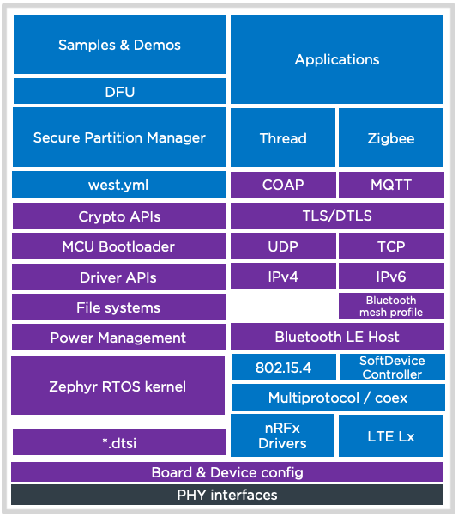
Nordic synchronizes with external repos
nRF Connect SDK is a single platform
All source code is distributed by Nordic
Includes open-source code from external projects
Nordic contributes to, and synchronizes with external projects
Nordic runs integration test on all source code and manages configuration
Customers clone a tag using git and west
External project repositories
Contribute
Synchronize
Access with
West / Git
Continuous integration
tests
Notes:
Customer does not need to worry about synchronizing with external repositories

Slide 11

RTOS
Introduction

Slide 12
What is an RTOS?
Samples & Demos
Applications
DFU
Real Time Operating System
Goal is to ensure predictable/deterministic execution pattern
Embedded systems often have strict timing requirements
Scheduler decides which task to execute at which time
Achievable by setting a priority for each execution thread
Secure Partition Manager
Thread
Zigbee
west.yml
COAP
MQTT
Crypto APIs
TLS/DTLS
MCU Bootloader
UDP
TCP
Driver APIs
IPv4
IPv6
File systems
Bluetooth mesh
Power Management
Bluetooth LE Host
Zephyr RTOS kernel
802.15.4
Bluetooth LE Controller
Multiprotocol / coex
nRFx Drivers
LTE Lx
*.dtsi
Board & Device config
PHY interfaces
Notes:
Kconfig files are part of all External and Nordic repository source code
Permissive means there are minimal restrictions to distribution

Slide 13
Why use an RTOS?
Samples & Demos
Applications
DFU
How does an RTOS help a product developer?
Separation of Concern
More portable & re-usable applications
Controls application complexity in large memory devices
Higher-level programming model
-> faster time to market
Secure Partition Manager
Thread
Zigbee
west.yml
COAP
MQTT
Crypto APIs
TLS/DTLS
MCU Bootloader
UDP
TCP
Driver APIs
IPv4
IPv6
File systems
Bluetooth mesh
Power Management
Bluetooth LE Host
Zephyr RTOS kernel
802.15.4
Bluetooth LE Controller
Multiprotocol / coex
nRFx Drivers
LTE Lx
*.dtsi
Board & Device config
PHY interfaces
Notes:
Separation of concern
Build modular code -> use same modules which provide a certain functionality in different products, certain inputs & outputs
Abstract out the timing requirements via the real time scheduler
https://www.freertos.org/FAQWhat.html#WhyUseRTOS

Slide 14

nRF Connect SDK
Details

Slide 15
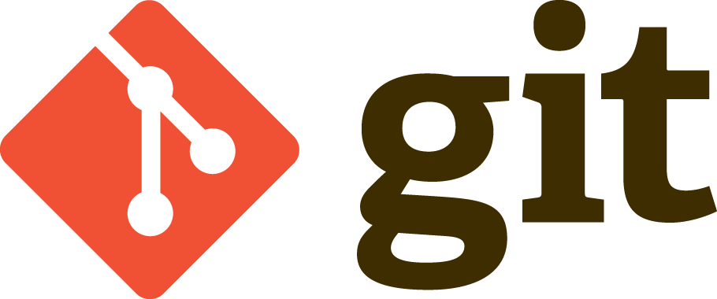
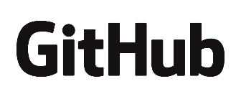
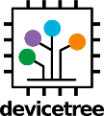
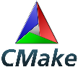
Tools
Use the same tools to manage your code
Your code can be in separate repositories from nRF Connect SDK and open source
Simplify incorporating new versions of SDK or patches
Facilitate scalable development for multiple products and multiple teams in your organization
Notes:
Different tools explained in a later slide

Slide 16
Tagged vs main branch
Tagged versions of nRF Connect SDK are stable releases
https://github.com/nrfconnect/sdk-nrf/tags
V2.1.1 is latest tagged revision
Technical support is available
Use as starting point for development
Main branch is most current development status
Newest version of nrf repository, not a stable release
No technical support available
Use if you need to test latest features earlier
Notes:
NCS v1.4.0 adds production support for Thread on 52833 and 52840, including multiprotocol support together with Bluetooth LE
NCS v1.2.1 added nRF9160 production support

Slide 17
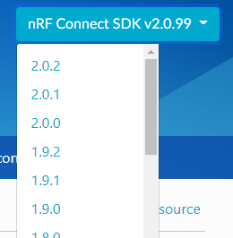
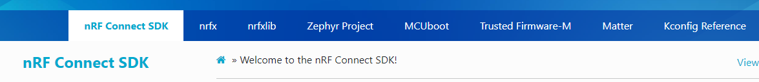
nRF Connect SDK documentation
Documentation link
Click on arrow in top right to choose documentation tag
2.x.99 refers to main branch
Latest tag is 2.1.1
Click on the tabs on the top banner to switch to nrfxlib, Zephyr, MCUboot or other documentation pages
Notes:
Documentation tag corresponds to same NCS tag
1.4.0 released 30.10.2020

Slide 18
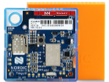
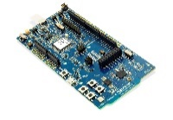
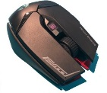
Manage source code and configurations
West
Multi-repository management tool
Kconfig
Source module / feature configuration for compile
DeviceTree
Target Board / Device description
Clone / update
Configure features
Configure target
nRF Connect SDK
west.yml
*Kconfig & prj.conf
*.dts
nrf
Application 1
nrfxlib
MCUboot
Code Base
Application 2
Zephyr
Application …
Your Code
Notes:
These tools allow you to:
Build multiple applications,
for multiple boards,
from one code base,
without porting / changing any program code
One application may require GPS functionality, another would require Bluetooth LE or Thread/Zigbee
Dts used to configure gpio mapping, etc.
West.yml file includes commits of the different repos to point to

Slide 19
West tool
West init
Initialize a new west installation
git checkout <tag>
e.g. git checkout v1.8.0
West update
Used to update the four repositories
v1.9.1
v2.1.1
main
nRF Connect SDK
nrfxlib
Zephyr
MCUboot
Notes:
When in v1.0.0 branch, to update to v1.1.0, all you have to do is open a command prompt window inside the nrf folder, then type git checkout v1.1.0 and then run a west update.
This then updates the respective other repositories to the correct commit (i.e. nrfxlib, zephyr, MCUBoot)

Slide 20
West tool
Using git and west simplifies multi repository management by making it seem you are only updating one repo
Simple to migrate between different tags
v1.9.1
v2.1.1
main
main
nRF Connect SDK
nrfxlib
Zephyr
MCUboot
Notes:
When in v1.0.0 branch, to update to v1.1.0, all you have to do is open a command prompt window inside the nrf folder, then type git checkout v1.1.0 and then run a west update.
This then updates the respective other repositories to the correct commit (i.e. nrfxlib, zephyr, MCUBoot)

Slide 21
nRF Connect SDK
Toolchain
Kconfig
Device Tree
Kconfig
Generates definitions to configure the system (e.g. GPS, MQTT settings)
Generally located in an example folder
Software features defined in Kconfig, enabled in prj.conf file
Kconfig and prj.conf files merged into one .config file for CMake
→ Configure software features without changing source code
CMake
Ninja
gcc
Notes:
Kconfig files are part of all External and Nordic repository source code
Info found from here: https://devzone.nordicsemi.com/nordic/cellular-iot-guides/b/getting-started-cellular/posts/nrf-connect-sdk-tutorial

Slide 22
nRF Connect SDK
Toolchain
Kconfig
Device Tree
DeviceTree (dts,dtsi)
Describes HW, pin layout
Allows for flexible HW modification via an overlay file
→ Build for different PCB designs and SoCs without changing source code
CMake
Ninja
gcc
Notes:
Kconfig files are part of all External and Nordic repository source code
Info found from here: https://devzone.nordicsemi.com/nordic/cellular-iot-guides/b/getting-started-cellular/posts/nrf-connect-sdk-tutorial

Slide 23
nRF Connect SDK
Toolchain
Kconfig
Device Tree
CMake
Generates build files
Ninja
Similar to make
Faster than make when performing incremental builds
Requires CMake in order to generate build files
gcc
Creates executables (hex file)
CMake
Ninja
gcc
Notes:
Incremental builds: not much has changed between the two builds
Ninja used in Google Chrome & Android development
https://en.wikipedia.org/wiki/Ninja_(build_system)

Slide 24
Release cycles
Regular releases (e.g. quarterly)
Publicly hosted on GitHub
Fixes released as needed
Long term supported releases can have fixes applied and delivered after new releases
Latest development version available
Version control management with Git:
manage new version and fix adoption
tool supported merging
Latest
(Main)
Release cycle
Major
Minor Tag
Tag vX
.
0
vX
.
Y
Fix
Fix
vX
.
0
.
vX
ZZ
.
0
.
Z
Notes:
Zephyr provides backward compatible APIs for two releases of Zephyr
Use git for configuration management and easy code migration between different version of NCS
Do upmerges with git

Slide 25

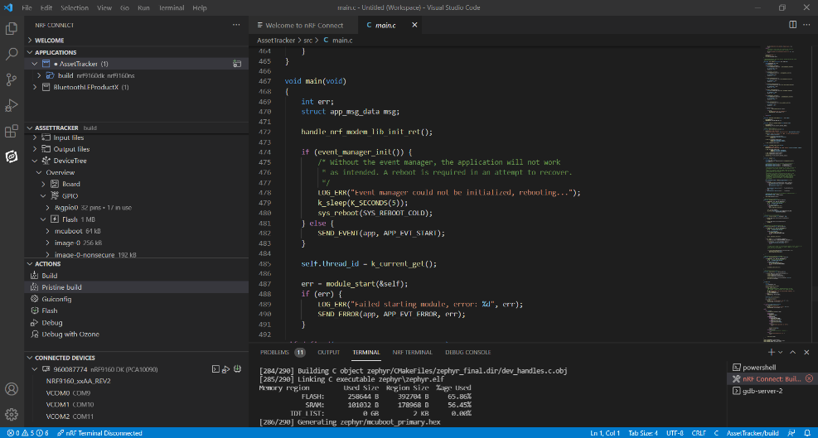
IDE support
nRF Connect for Visual Studio Code
Built from the ground up for nRF Connect SDK
Highly extendable and configurable
CLI and GUI Interfaces
Cross-platform support
Windows, macOS, Linux
Create new board wizard
Rich set of tutorial videos

Slide 26
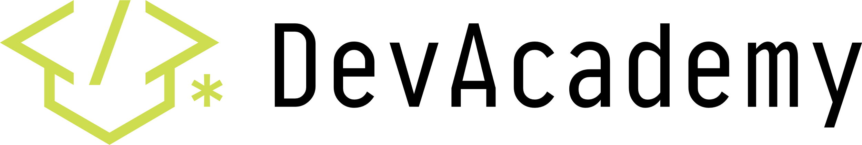
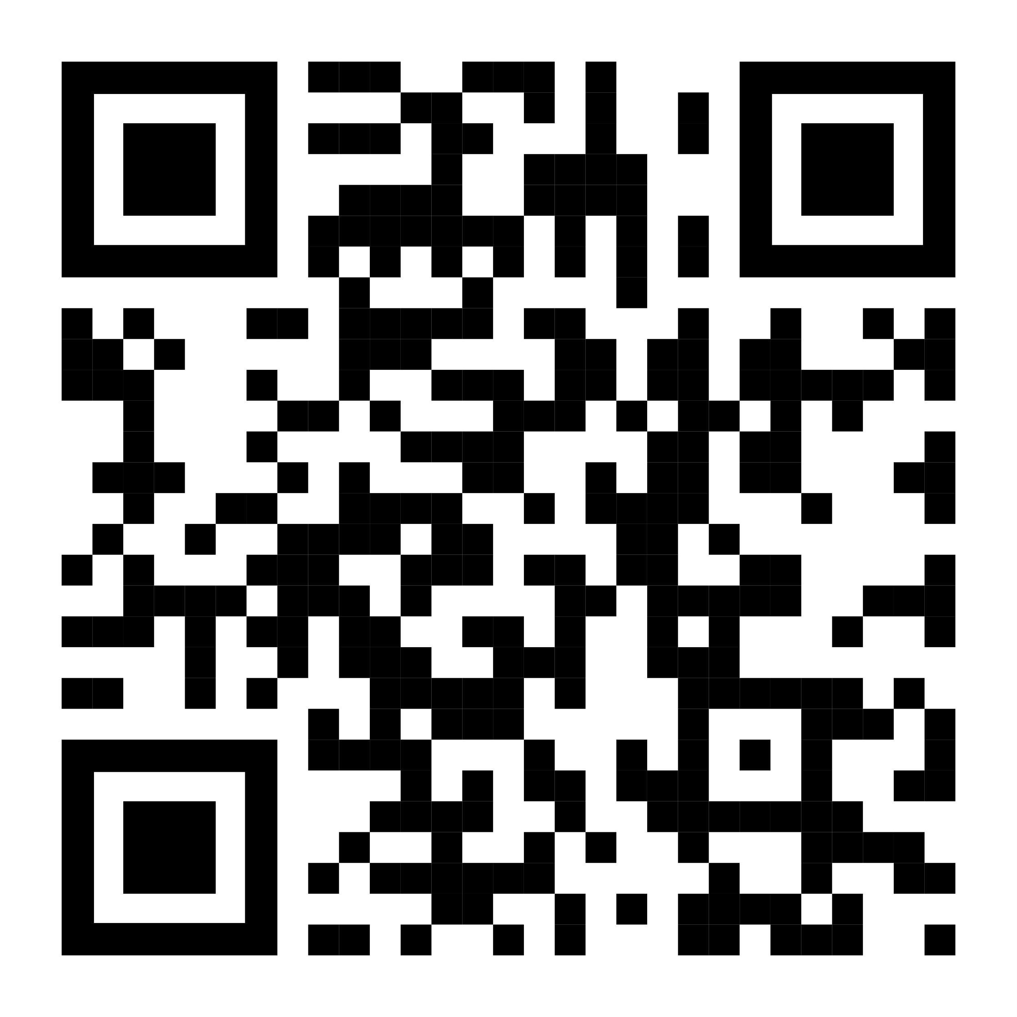
nRF Connect SDK fundamentals course
Self-paced hands-on online course focusing on learning the essentials of nRF Connect SDK.
Lots of hands-on exercises.
Centralized up-to-date content.
Protocol agnostic (cellular IoT, Bluetooth LE, Bluetooth mesh, etc..).
Supports all our DKs and the Thingy:91.
Ideal for new users of nRF Connect SDK or users switching from nRF5 SDK to nRF Connect SDK.
Test your knowledge through interactive quizzes.

Slide 27
nRF Connect SDK
Evolution

Slide 28
Ported SoftDevice Controller
Market leaders in Bluetooth LE in large part to our nRF5 SDK + SoftDevice
Link Layer (LL) enables best in class interoperability between SoC and smartphones and is difficult to get right
Ported the SoftDevice LL to nRF Connect SDK
Ensures best in class smartphone interoperability in nRF Connect SDK vs nRF5 SDK + SoftDevice
User application
Alert Notification
Blood Pressure
Glucose
Heart Rate
HID over GATT
Proximity
Proprietary
Profiles
…
GATT
GAP
Host
ATT
SMP
L2CAP
Link Layer (LL)
Controller
Physical Layer (PHY)
Notes:
Interoperability very important for industries such as bike sharing and wearables, our 40% market share in Bluetooth LE speaks volumes
LL and PHY are part of the Bluetooth LE Controller (SD Controller), SoftDevice API to L2CAP are part of SoftDevice Controller
LL controls radio timing and helps with throughput and stability

Slide 29
SoftDevice Controller
The standalone SoftDevice Controller library is now the default Bluetooth LE Controller for Bluetooth samples
SoftDevice (nRF5 SDK)
nRF Connect SDK
GATT
GAP
Zephyr Bluetooth LE Host
Host
ATT
SMP
HCI
L2CAP
SoftDevice Controller
Link Layer (LL)
Multi-Protocol Service Layer (MPSL)
Controller
Physical Layer (PHY)
Physical Layer (PHY)
Notes:
Let’s start with Bluetooth.
When you develop a Bluetooth Low Energy (LE) application, you must include a Bluetooth LE Controller. A Bluetooth LE Controller is the layer of the Bluetooth stack that handles the physical layer packets and all associated timing. It implements the Link Layer, which is the low-level, real-time protocol that controls the Bluetooth LE communication.
The nRF Connect SDK contains two implementations of a Bluetooth LE Controller: the SoftDevice Controller and Zephyr Bluetooth LE Controller. In previous releases of NCS Nordic’s Bluetooth LE Controller was called nRF Bluetooth LE Controller and now is renamed to SoftDevice Controller. It is possible to select either Bluetooth LE Controller for application development, however the SoftDevice Controller is now the default Controller for Bluetooth samples.
So why to use the SoftDevice Controller?
Firstly the SoftDevice Controller provides the same implementation of the Link Layer that is available as part of Nordic Semiconductor’s SoftDevices. The main reason behind the name change was to emphasise that fact. This link layer has been used in hundreds of milions of products available on the market and as a result ensures great interoperability.
Secondly, the SoftDevice Controller supports an extensive standard feature set from the Bluetooth 5.2 specification and a number of extensions for high-performance applications like Low Latency Packet mode not available in Zephyr Bluetooth LE Controller.

Slide 30
nRF Connect SDK Tools
Tools and development environment for nRF Connect SDK
H2, 2022
Nordic Tech Tour 2022

Slide 31
nRF Connect Tools
Consist of
nRF Connect for Desktop
nRF Connect for VS Code
nRF Command line tools
Zephyr project tools

Slide 32
nRF Connect Tools supported platforms
nRF Connect Tools has been developed and tested on the following operating systems:
Windows 10 running x86 CPUs
macOS 11 running x86 and Apple Silicon MCUs
Ubuntu 20.04LTS running x86 CPUs
Older versions of the operating systems will typically not work
Newer versions may work but this is not guaranteed
Notes:
Newer versions will be phased in as they stabilize. This phase-in policy and the currently will be added to the nRF Connect documentation in the near future
nRF Command line tools has a slightly wider offering of supported platforms

Slide 33
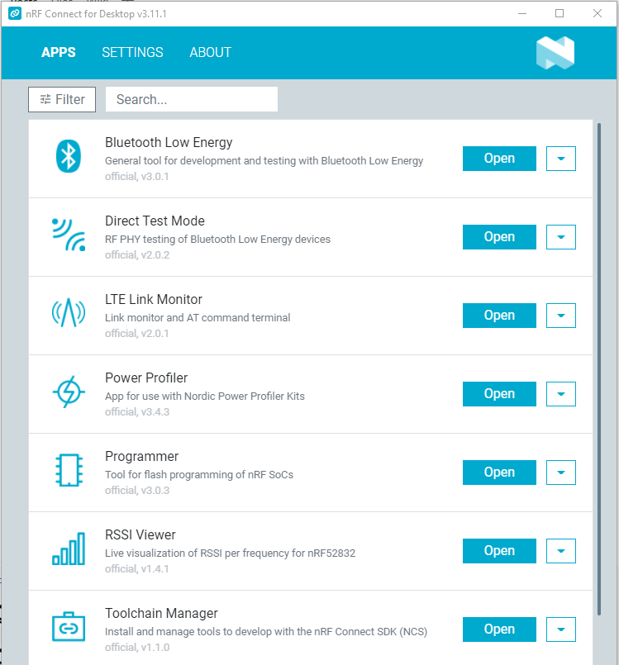
nRF Connect for Desktop
Tools aimed at SW development and general use:
Toolchain Manager installs and manages tools related to nRF Connect SDK
Programmer is a great visual tool for flashing Nordic devices, updating modem FW on nRF91 Series
Power profiler used to optimize power consumption
Notes:
Toolchain manager is available for nRF Connect SDK 2.0 onwards
Power Profiles must be used with Power Profiler Kit (PPK) or PPK2

Slide 34
Short range tools
In nRF Connect for Desktop
Bluetooth Low Energy
Connect it to advertising devices
Discover their services
Maintain connection and parameters
RSSI Viewer
Visualizes energy in all channels
Direct Test Mode
Test TX and RX
Changes channel, transmit power, packet size
Notes:
Bluetooth Low Energy only support features from SoftDevice ~4year back,
All apps require a devkit or dongle, refer to doc for required kit pr app
Bluetooth Shell in zephyr is an embedded alternative supporting later features

Slide 35
Cellular tools
In nRF Connect for Desktop
Trace Collector v2 preview
collect modem traces on nRF91 Series
Interface to Wireshark
LTE Link Monitor
monitors nRF91 Series connection status
sends AT commands
updates certificates
Notes:
Trace Collector V2 preview is in the process of replacing Trace Collector AND LTE Link Monitor, Trace Collector V2 preview will be renamed to Cellular Monitor once this is completed

Slide 36
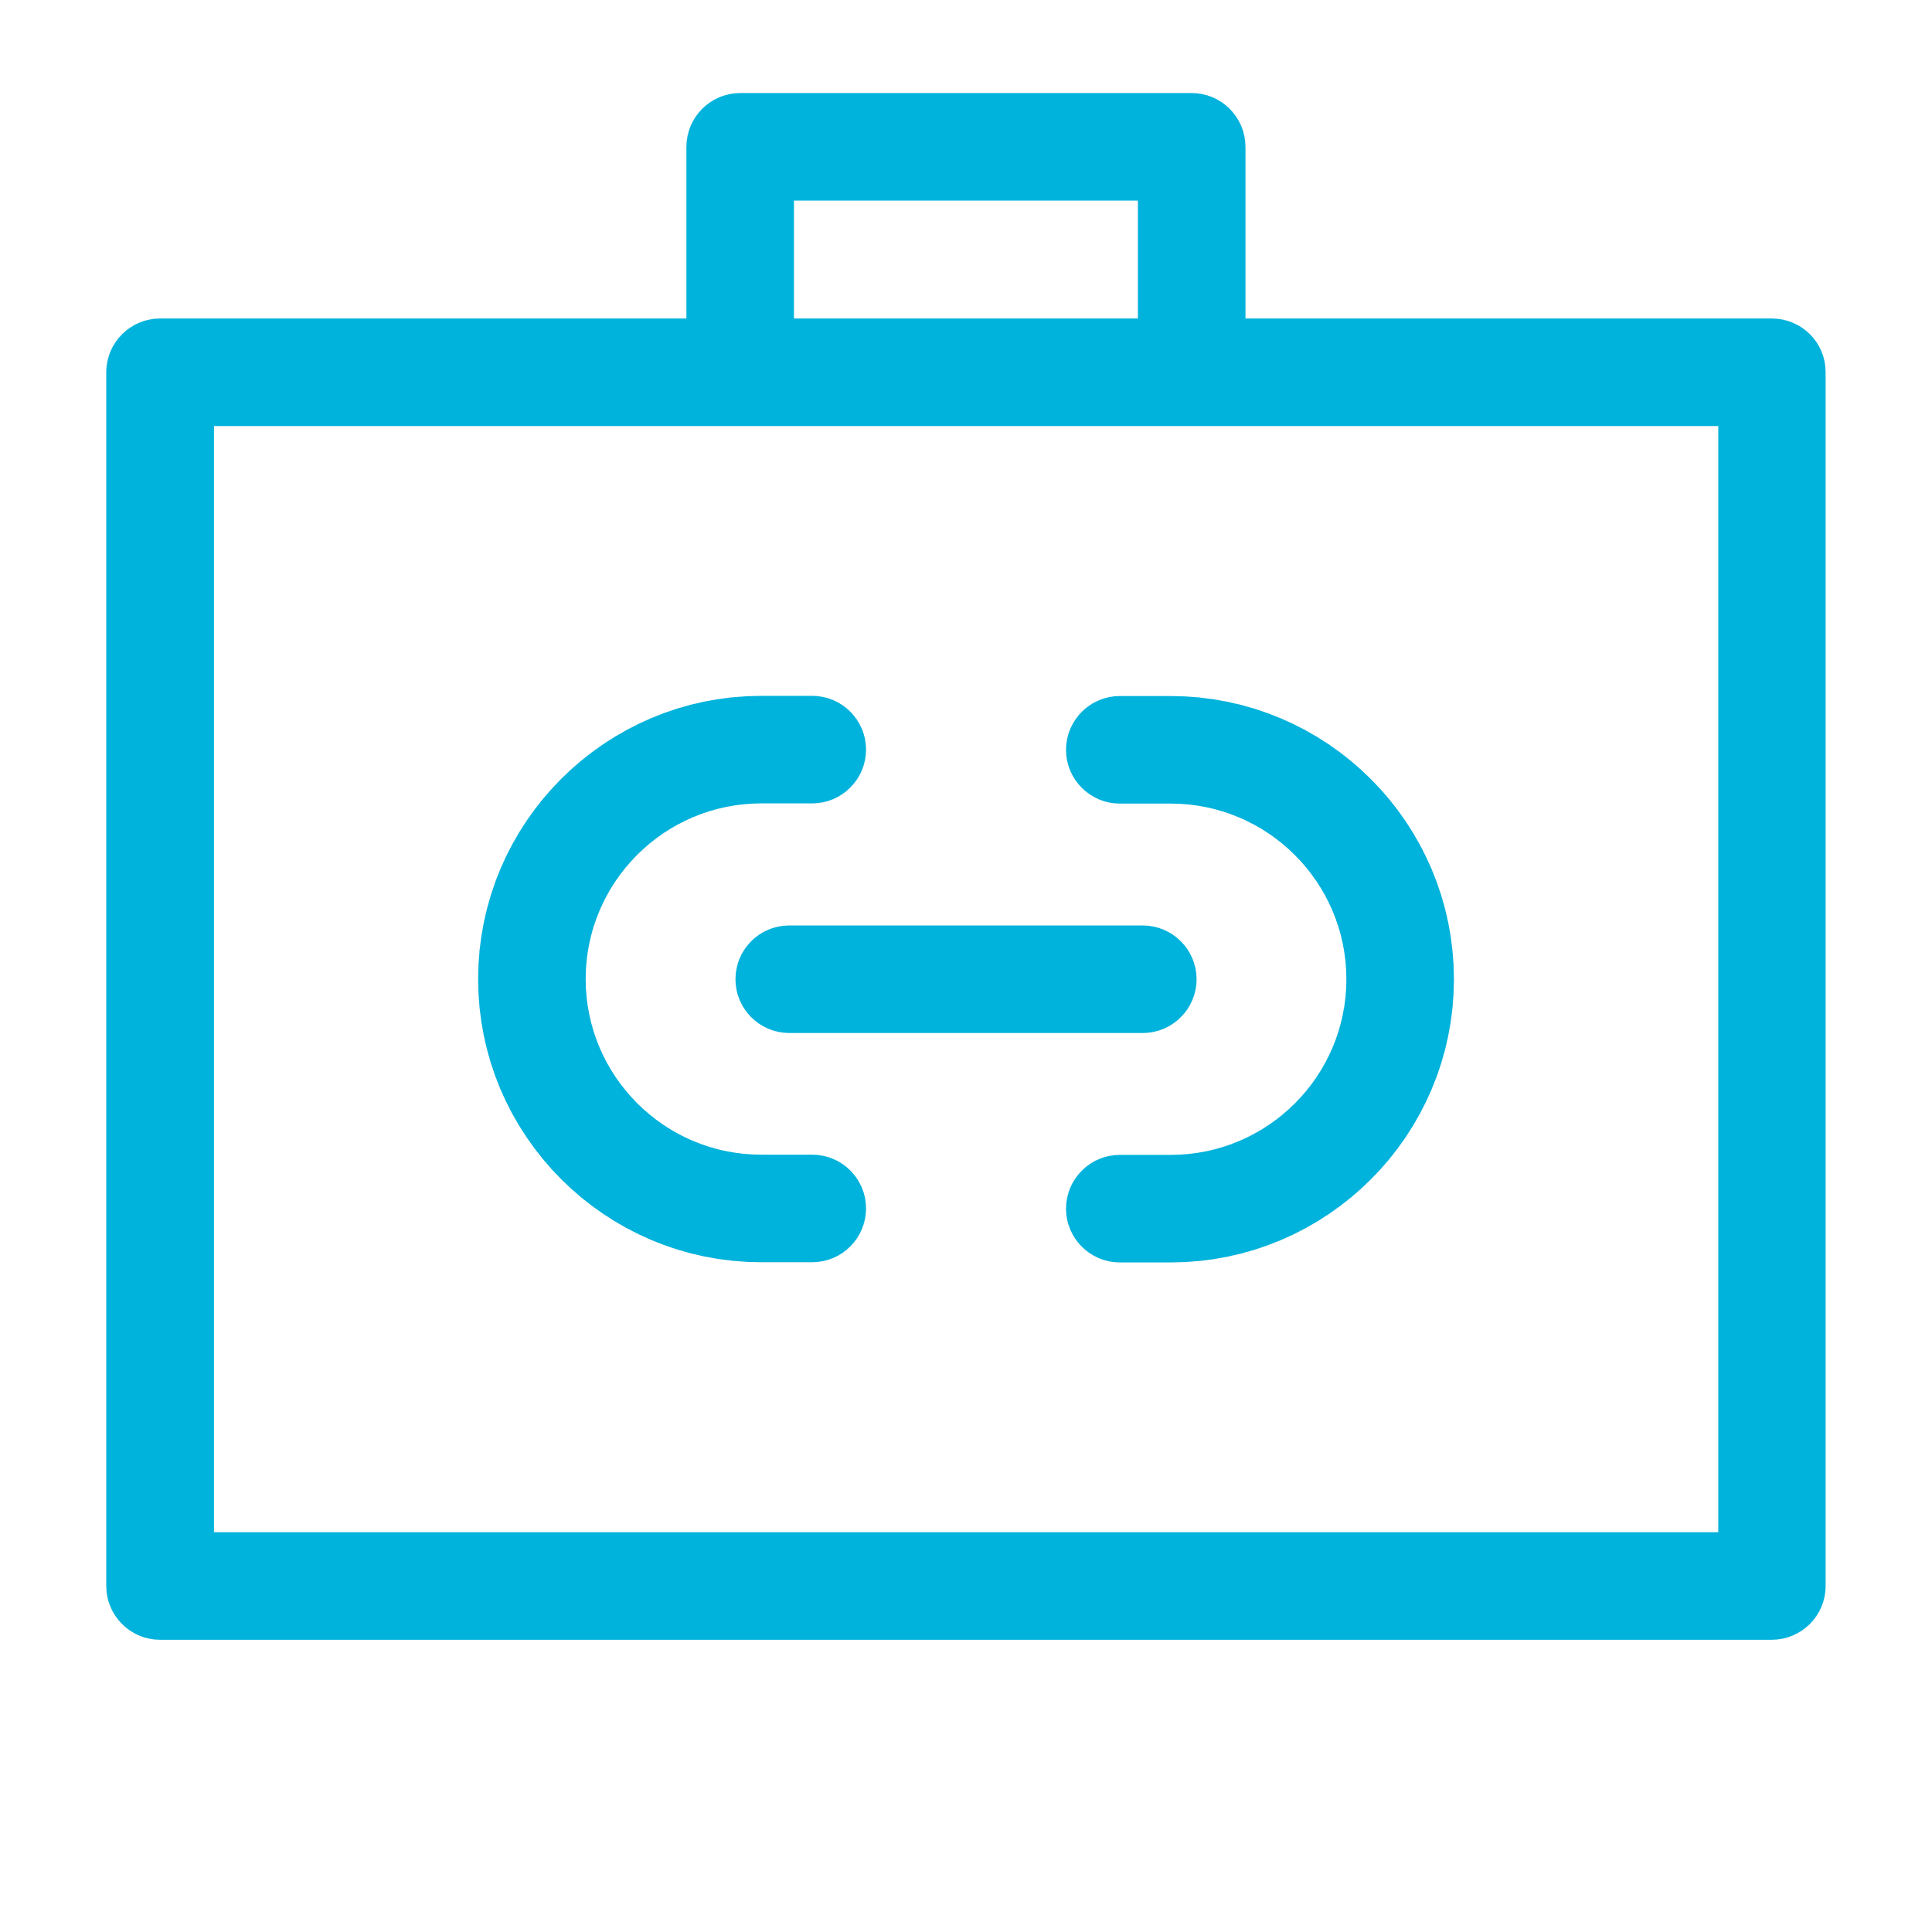
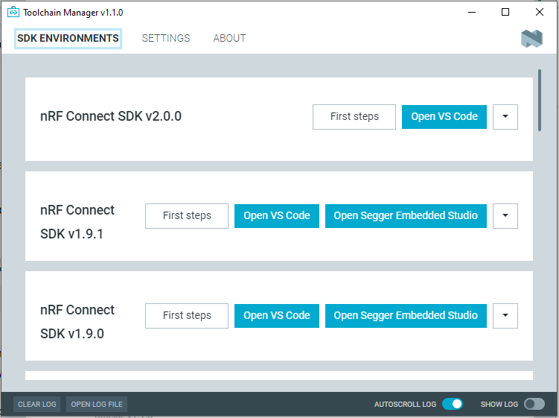
Toolchain Manager
Provides single click download of
Entire code base
Toolchain and supporting tools
Available for
Windows, macOS for all nRF Connect SDKs
Linux for SDK 2.0 onwards
Makes a copy of each version (tag)
allows working on multiple versions
Helps on installing required tools
Notes:
Does not require admin rights except installer for USB drivers that might required this
Manual installation can be done using the nRF Connect SDK /zephyr getting started
documentation

Slide 37
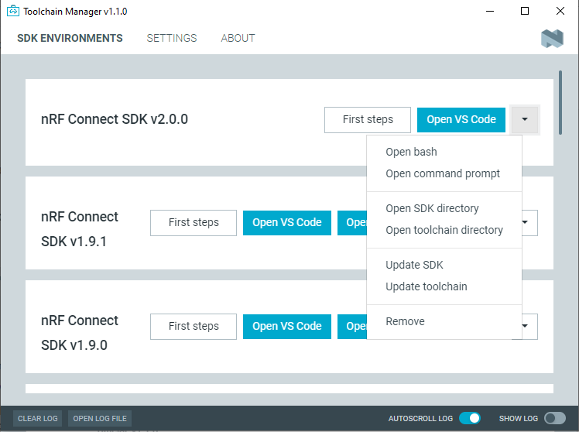
Toolchain Manager
VS Code is the recommended IDE
VS Code may launch directly from your system/desktop
Use the Open bash/command prompt/terminal to use this SDK version from CLI
Segger Embedded Studio must be launched from the Toolchain Manager (not recommended for new designs)
Notes:
Segger Embedded Studio is not recommended for new designs
Designs started in Segger Embedded Studio can be opened in VS Code for continued work
Manual installation can be done using the nRF Connect SDK /zephyr getting started documentation

Slide 38
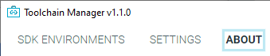
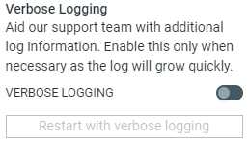
Toolchain Manager, continue
If problems during installation:
Try the update functions
View the logfile for full details
Turn on Verbose Logging in the “About” menu

Slide 39
Tools for building nRF Connect SDK
Kconfig:
Generates definitions to configure the system
Software features defined in Kconfig, enabled in prj.conf file
DeviceTree:
Describes HW, pin layout
Allows for flexible HW mods via an overlay file
Cmake: generates build files
Ninja: Like make, but faster..
Gcc: Creates executables
Kconfig
Device Tree
CMake
Ninja
gcc
Notes:
Kconfig files are part of all External and Nordic repository source code
Info found from here: https://devzone.nordicsemi.com/nordic/cellular-iot-guides/b/getting-started-cellular/posts/nrf-connect-sdk-tutorial
Ninja is faster on incremental builds: not much has changed between the two builds, requires Cmake to generate build files
Ninja is used in Google Chrome & Android development
https://en.wikipedia.org/wiki/Ninja_(build_system)

Slide 40
IDE support
nRF Connect for Visual Studio Code
Installed via the Toolchain Manager
Built from the ground up for nRF Connect SDK
Highly extendable and configurable
CLI and GUI Interfaces
Create new board wizard
Built-in terminal
Rich set of tutorial videos
Notes:
VS Code can be launched directly from your desktop/system and does not require to be launched from the Toolchain Manager like Segger Embedded Studio does
nRF Connect for VS Code is the IDE supported by Nordic for nRF Connect SDK 2.0.0 onwards
Segger Embedded Studio is also supported for nRF Connect SDK 1.x versions
Segger Embedded Studio is still the preferred (free of charge) IDE for nRF5 SDK and will be supported

Slide 41
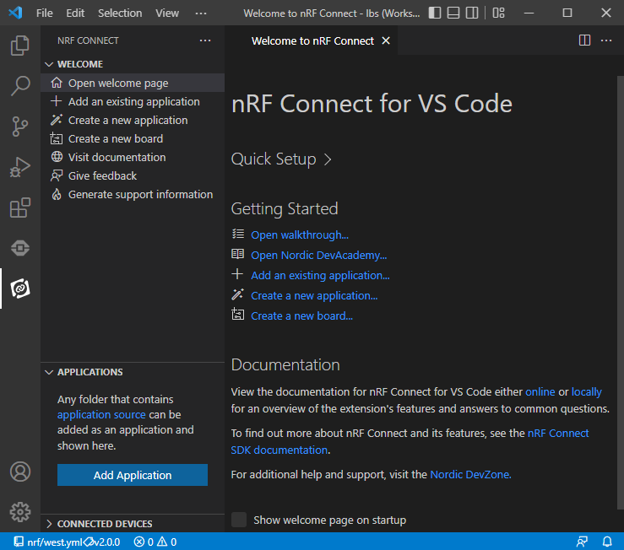
Setting up nRF Connect for VS Code
The welcome page
Quick Setup:
Sets the Toolchain (and SDK) versions
This is valid for the whole VS Code workspace
Can be used to change toolchain version in existing applications
Getting Started:
Open walkthrough: A set of short videos
Nordic DevAcademy : More deep diving tutorials
Links to documentation
New features can be found locally under
Please visit the documentation site: nRF Connect for VS Code

Slide 42
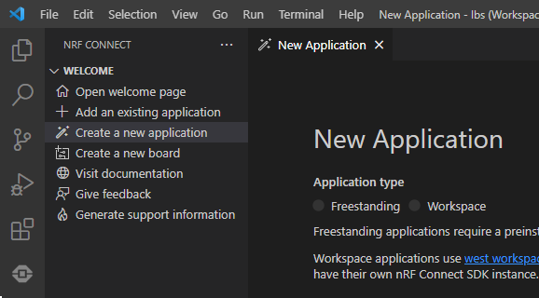
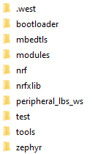
Setting up a new application
3 different ways of setting up a new application:
Add an existing application:
This opens an existing project which can be a sample in the repo or a project from Segger Embedded Studio or command line
To use select the folder containing the file cmakelist.txt
Create a new application → Freestanding:
Copies the application files (but not the SDK files) to a new folder.
Suitable for evaluation or multiple projects using the same SDK
Create a new application → Workspace
Workspace here means a west workspace.
Copy the sample files and clones the SDK into the VS Code workspace folder.
Suitable for project where it is important to have a full copy of all the files in the project.
Notes:
We will use a “freestanding” sample in the rest of this presentation
Dir structure for workspace application shown

Slide 43
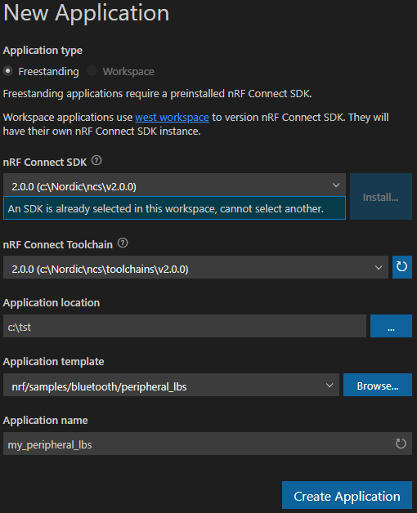
Setting up a new application, continue
Select the SDK and Toolchain versions
Set App location
The app will be created in a subdirectory in this directory
Select the template (aka “sample”)
Just start typing the sample name and it will present you a list matching what you have typed
Or use the sample browser
Finally click “Create Application”
Notes:
SDK and Toolchain version may be changed later in the quick setup
If you have set up an SDK and Toolchain version in your VS Code workspace the version cannot be change in this view; you must the change it in the Quick Setup
Typically you set the toolchain version to the same as the SDK version

Slide 44
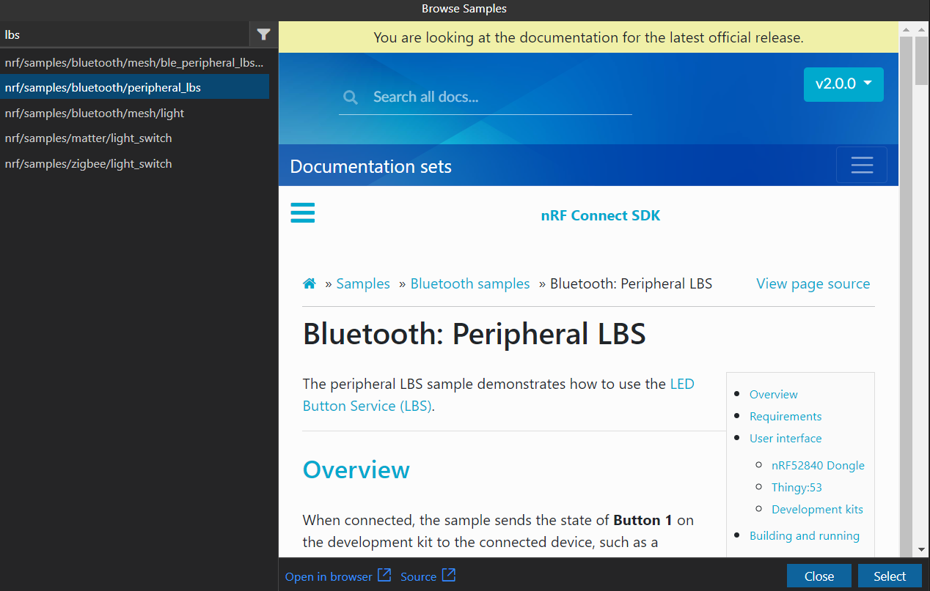
Using the sample browser
Start typing to filter on name
More search filters
Click the app template to view doc
Click “Select” to use this template
Click to open this doc in your systems web-browser

Slide 45
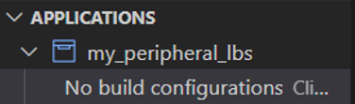
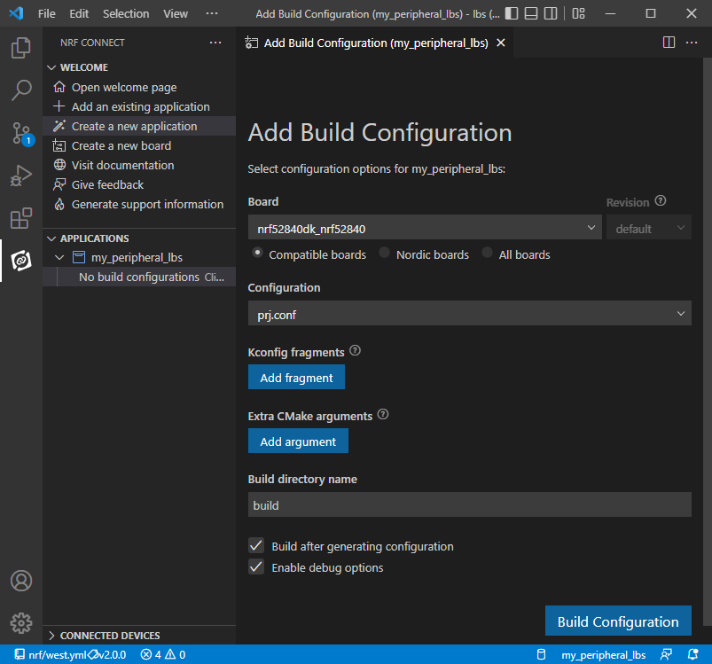
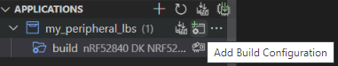
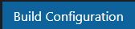
Setting up build configurations
Click to start the configurator
Select your board
Select you conf-file from the pull-down menu
Add Kconfig fragments and Extra Cmake arguments if needed
Click for more info
Select the name of this configuration
“Enable Debug Options” if debugging is to be used
And finally click
Notes:
You may configure many configurations for each app, for instance “debug” and “release”

Slide 46
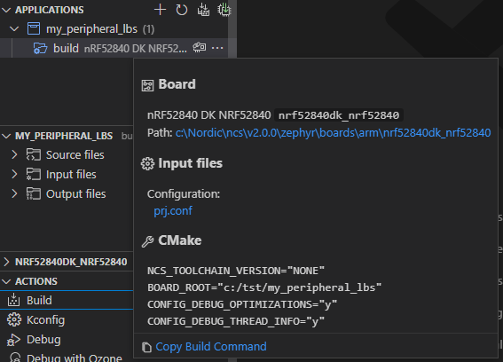
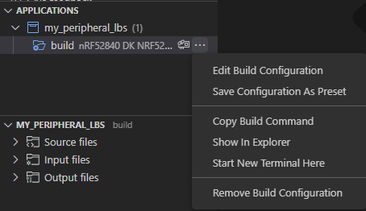
A few nice features in build configs
Mouse-over will show build settings
Click the to activate the sub-menu
Edit build configuration
Changes the build setting of this build
Save Configuration As Preset
See next slide for info on preset file
Copy build command:
Wil copy the full west build command to the clipboard
Show in Explorer
Goes to the build directory in the VS Code explorer
Start New Terminal
Will open a VS Code terminal in build directory

Slide 47
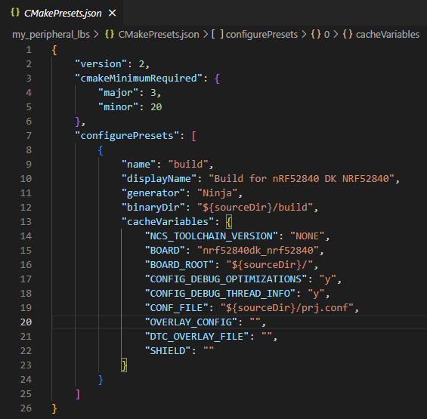
The Cmake preset file
Contains all configuration settings
Can be shared between machines
Allows multiple build targets
Using preset files with west:
Generic command:
west build -d ${targetDir} -- --preset ${presetName}
For our demo case where the environment is set up simply:
west build -- --preset build
Notes:
When setting up a new build config when a preset file is present it is possible to “pre-fill from preset” by selecting the “name”; in this case “build”

Slide 48
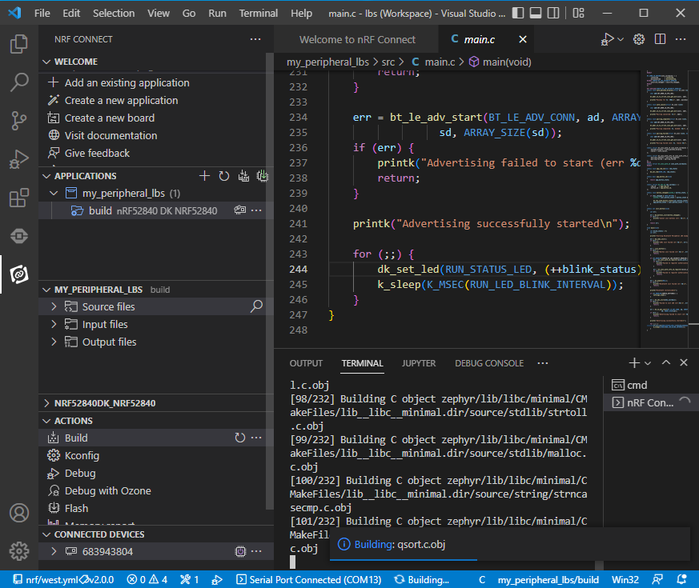
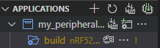
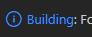
Building your first app
To (re)build you app click “build” in the Actions view
Click her to force a pristine build (a forced full build)
If you have several applications or build configurations, you can build all with one click:
Building progress can be viewed by clicking

Slide 49
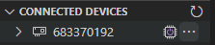
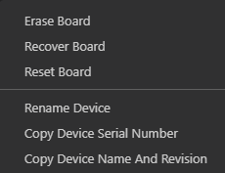
Flashing connected boards
Link your build config to a connected board
And flash all linked boards with one click
Flash your active build
Give your board a name:

Slide 50
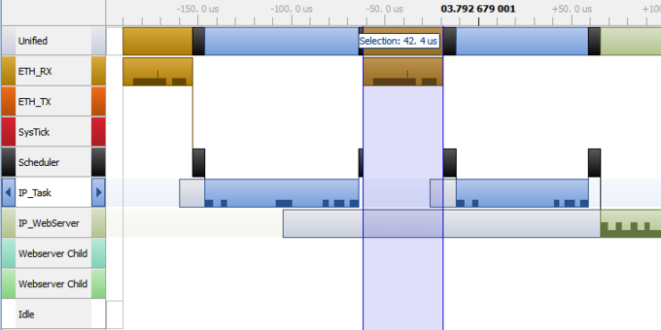
Debugging time critical code
Debugging while running time critical apps like comms stacks:
Use the logging feature or “printf”:
Logging — nRF Connect SDK Documentation
NB: “printf” can be intrusive
Use Segger SystemViewer
Will visualize the program flow
Segger SystemViewer must be enabled in Kconfig
Using stop-mode debugging (breakpoints) will break the comms link
Notes:
“Monitor mode” debugging is currently not supported in Zephyr
NB: “printf” can be blocking and break comms stacks while RTT doesn’t require any additional HW resources
https://developer.nordicsemi.com/nRF_Connect_SDK/doc/latest/zephyr/services/logging/index.html#

Slide 51
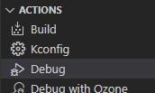
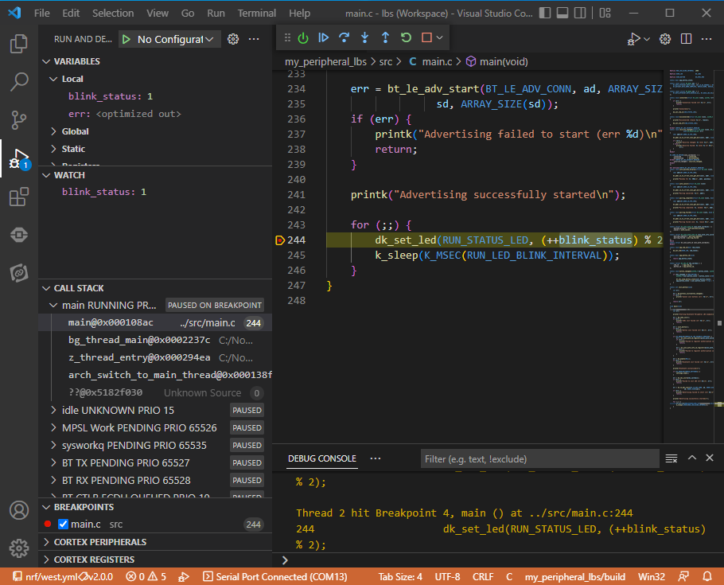
RTOS aware debugging
Start your debug session in the Actions pane
Controls to operate the debugger
Toggle breakpoints by clicking
Hint: Right-click on breakpoint for “smart” breakpoints
Use GDB console directly here
NB: Remember to build for debugging…
Notes:
Smart breakpoints are “Intrusive” breakpoints, meaning the CPU is stopped at every hit but automatically starts again when criteria is not met

Slide 52
RTOS aware debugging, continue
Variables:
Add watch by right-click variable
When paused view value by mouseover
RTOS in Call Stack View:
Thread name and status
Thread call stack when paused
MCU peripheral’s and register views

Slide 53
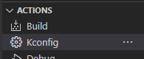
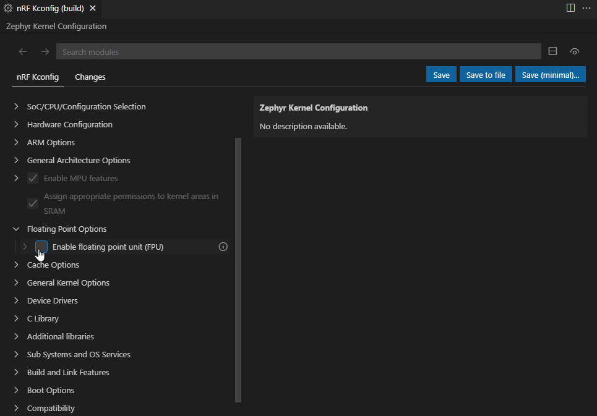
Configuring using nRF Kconfig
Start nRF Kconfig from Actions
nRF Kconfig features:
Fuzzy search box
3 save options:
Save saves temporary changes to the <build>/zephyr/.conf file (a pristine build will revert these changes).
Save to file saves changes to an existing .conf file.
Save (minimal) saves the smallest subset of settings to a new .conf file which can be uses as an Kconfig fragment file
Notes:
This assumes basic Kconfig knowledge…
Showing only built-in nRF Kconfig, menuconfig and guiconfig is covered in the zephyr project
Fuzzy search means that the phrases don’t need to be precisely written
(Kconfig fragment files are sets of configurations grouped together, for instance “debug” or “power-optimized”)

Slide 54
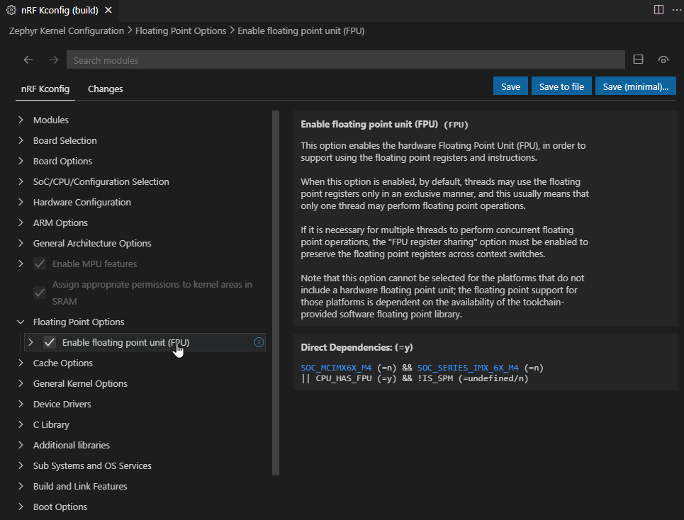

Using nRF Kconfig, continue
Navigation buttons
Jump to item in the tree
View information
Shows dependencies with clickable links:
nRF Kconfig help (online)
Kconfig language help (online)

Slide 55



Defining your own board
Click to create the board
Follow the guide and mouseover for help
Complete by clicking
You have now created the file structure for a new board
Notes:
The created file structure is for a new board which contains an SoC only. To give the board features i.e. connect peripherals and GPIOs use the DeviceTree extension as described in the following slides

Slide 56
DeviceTree
DeviceTree is a system and language for defining the hardware layout of a custom board in a hierarchical tree structure. In a typical scenario, a developer will have several different devices, such as LEDs, a display, and sensors, all of which need to be configured. This configuration is done in the DeviceTree language
Introduction to DeviceTree (online)
Video on Device drivers, covers DeviceTree as well: watch on YouTube
Notes:
Plenty of details in the following DeviceTree slides, can be skipped and refer audience to read themselves

Slide 57

nRF DeviceTree
DeviceTree contexts:
DeviceTree contexts consist of a board file and a list of overlay files. Each context corresponds to a single compiled DeviceTree file that goes into a build.
If you work with more than one application or board, you will have multiple sets of DeviceTree contexts - one for each of your builds. Every time you open a new DeviceTree file, the extension will add a DeviceTree context unless this file is already part of an existing context
The DeviceTree contexts show up in the DeviceTree View in the Sidebar (this view will be named after your board once this is set up)
Each DeviceTree context presents an overview of common resources and their users. Each entry in the overview is linked with a specific node or property in the DeviceTree. Clicking one of these will go to the primary definition to the linked node or property.

Slide 58

Using the nRF DeviceTree view
Aliases:
Within the contexts, you can create a DeviceTree alias on a selected node if applicable. To do this:
Select the node you want to create an alias for.
Click on the More actions... menu icon.
Click on Add Alias.

Slide 59

The nRF DeviceTree view, continue
Board
This is a list of information related to your connected board. It includes the name, architecture, supported features, and supported toolchains
GPIO
This is a list of all known GPIO controllers, which are determined by the gpio-controller property. Each GPIO controller presents a list of the allocated pins and their owners inferred from gpios properties, -pins properties, and pinctrl properties.
The pin icon to the left of each GPIO pin indicates whether a pin is connected. A filled-in icon indicates a connected pin, and an unfilled-in icon indicates an unconnected pin.
The GPIO context also lets you copy the associated C identifier of a given node using the action Copy C Identifier of Node.

Slide 60

The nRF DeviceTree view, continue
Flash
This is a list of all flash controllers, or nodes, based on the soc-nv-flash type binding.
Interrupts
This is a list of all interrupt controllers determined by the interrupt-controller property. It lists the allocated interrupts on the controller and their users, as well as any other available information, such as their priority and index.
When hovering over a node, the More actions... menu icon appears to the right. Click on it to access the following actions:
Edit Property Value - edit the value of the selected node in the target DeviceTree file.
Disable Node or Enable Node - disable or enable the selected node.
Remove node - remove the selected node from the target DeviceTree file.

Slide 61

The nRF DeviceTree view, continue
Buses
This is a list of all known buses on the device determined by the bus entry in the node's type binding. It lists important properties of the bus, as well each node on the bus and their address if the bus has an address space. If the bus is an SPI bus, the chip select configuration of each node is also listed if it is known.
When hovering over a node, you can see a description of the node's binding. You can also see the More actions... menu icon to the right:
Enable Node or Disable Node - opens the .overlay file in the editor and sets status = disabled" or "enabled".
Add Node to Bus - opens a drop-down list of available nodes to add to your board. After choosing a node, the .overlay file opens in the editor and the node information is added.
Remove Node - removes the selected node from the .overlay file.
The Buses context also lets you copy the associated C identifier of a given node using the action Copy C Identifier of Node.
Notes:
Two nodes connected to I2C shown

Slide 62

The nRF DeviceTree view, continue
ADC
This is a list of all ADC controllers on the device, or nodes, based on the adc-controller type binding. Each ADC controller contains a list of all allocated channels based on references made to the ADC instances using the io-channels property.

Slide 63

Using nRF DeviceTree, overlay files
DeviceTree overlay files:
Use to provide additional board functionality:
Enabling a peripheral that is disabled by default
Selecting a sensor on the board for an application specific purpose.
Adds application-specific modifications to the <board>.dts file
The build system concatenates the changes from the overlay files with the base DeviceTree file.

Slide 64

nRF DeviceTree, creating overlays
Click on the Input files. It will say "No overlay files. Click to create one". Click this on.
The generated .overlay file appears under Input files.
Notes:
When creating or removing an overlay file, a pristine build must be run for CMake to include the overlay file in the configuration. A notification appears and prompts you to do this. Click the Run Pristine Build button.

Slide 65

nRF DeviceTree, creating overlays
Adding a node to the overlay file
With the overlay file created, we can start adding nodes to the board:
Press Ctrl+Space to start the auto-completion feature and see a list of available nodes. For detailed information about writing property values, see the nRF Connect SDK documentation.
For an implementation example see: Creating an overlay file - nRF Connect for VS Code

Slide 66

nRF DeviceTree language support
Code completion:
Code completion will suggest as you type
Or press Ctrl+Space even before typing anything
Mouse-over will display info
Notes:
With context-aware autocompletion, you can speed up the process of adding properties, nodes, and values to overlay files

Slide 67

nRF DeviceTree language, continue
Add missing required properties:
A button with a light bulb icon appears next to the selected node in the Editor.
To add the missing required property, click on this icon + Add required properties
Fill inn the missing data

Slide 68

nRF DeviceTree language, continue
Syntax validation and highlighting
Built-in syntax checking
Validates the tree structure
points out potential issues in the tree (such as overlapping assignments or missing references)

Slide 69


nRF DeviceTree language, continue
Copy C identifiers
References to a can be copied
And pasted into C code
Right-click and choose: Copy C identifier
If the selected symbol has a corresponding C macro, like DT_PROP(DT_NODELABEL(adc), label), it will be copied to the clipboard.
A message shows up in the Status Bar with the copied string:

Slide 70

nRF DeviceTree language, continue
Copy C identifiers from a DeviceTree Node
To copy from a DeviceTree node:
Expand the appropriate section in the DeviceTree View.
Hover your mouse over the node you want to copy.
Click on the More actions menu icon.
Click on Copy C Identifier of Node.

Slide 71

nRF DeviceTree language, continue
Use in C-files:
C file macro argument completion
Uses data from the most recent DeviceTree
Provide arguments completion for:
DT_ALIAS
DT_NODELABEL
DT_PATH
DT_CHOSEN

Slide 72

nRF DeviceTree language, continue
Show compiled output:
Click to view the compiled DeviceTree
Opens in separate window.
Click any context item in the DeviceTree View and the compiled output will jump to that section in the code

Slide 73

nRF Terminal
Integrates with nRF Connect for VS Code
Connects over serial ports or RTT.
Uses Terminal Panel of the VS Code interface.
Reconnect automatically (but not for RTT).
This is a “simple” terminal.
If more advanced features are needed: Use a different terminal program
Full documentation for nRF Terminal can be found here

Slide 74



nRF Terminal, connecting a device
There are two way to connect:
From the Terminal title bar:
Start Terminal with new configuration
Start Terminal with previous configuration
From the Connected Devices View:
Click on the board you want to connect to.
A list of options appear.
Hover your mouse over the option that has a terminal icon and click on the plug icon.
Disconnecting:
Click the terminal info in the status bar

Slide 75


The memory report
A memory report can be generated here
Displays
A hierarchical list of RAM and Flash (ROM) symbols
Memory usage pr symbol
Each entry has right-click feature providing:
An identifier
If this is a code symbol a link to the source code is provided

Slide 76

nRF Connect for VS Code
Apps, configs and tips & tricks

Slide 77

Multiple apps, configs and devices
You can have many application in your VS Code workspace (2 shown)
Build all of them with one click
In nRF Connect for VS Code

Slide 78

Multiple apps, configs and devices
You can link a build configuration to a device and flash all linked devices with one click
You can have many configurations for the same application, for instance release and debug and build all configurations for one app with one click
In nRF Connect for VS Code

Slide 79



Using CLI with VS Code
VS Code refer to CLI as “Terminals”
You can open a CLI by clicking …
The terminal will get the correct settings for the configuration
You can have many terminals
Each terminal may have different settings
Notes:
VS Code refers to CLIs as “Terminals”
CLI can be configured in VS Code: cmd, PowerShell, bash ++

Slide 80


Editing tips and tricks
Pop-up documentation:
Mouse-over the text of interest
The API help or other info will pop up
Notes:
Currently the latest version (“master” or “main” as it’s called now) will be searched. NCS version may be changed in the doc page

Slide 81


Editing tips and tricks, continue
Search documentation:
Mark and right-click the text of interest
Select “Search Nordic’s Resources”:
Search in Nordic DevZone”
Search nRF Connect SDK Documentation
Code completion (almost always) available by clicking Ctrl+Space
Notes:
Currently the latest version (“master” or “main” as it’s called now) will be searched. NCS version may be changed in the doc page

Slide 82


Editing tips and tricks, continue
Searching:
Searching relates to the VS Code workspace
To include SDK files in search:
Click the Explorer icon
Click “Add Folder to Workspace…” and select the directory to include (will include subdirectories as well)
To search mark the text and click the relevant search icon in the application view
In this view only files included in the build are listed
Each directory level has a search icon for limiting the search to a part of the tree
Notes:
Searching the SDK: Sometimes too many files are part of the build, and an error occurs. Please reduce the file count by traversing down in the file tree

Slide 83
Search bug in July version
To be able to search using the search icons in the “Source Files”, “Input Files” in the application view a few tricks must be done:
Set up your applications and build configurations without saving a VS Code workspace.
Build all configurations once
Close workspace by clicking “close workspace” in the File menu.
Click the Explorer icon (in the upper left corner of VS Code)
Click the “Open Folder” button and navigate and select the folder containing your application (level above the build folders)
If prompted with Adding application to visible applications, click “Yes”
If prompted with SDK and Toolchain versions chose the SDK and matching toolchain versions
Click the nRF Connect for VS Code icon
You may now save your VS Code workspace and search will work as intended
This will be fixed in the next main version of nRF Connect for VS Code

Slide 84

nRF Command Line Tools
Offering: nrfjprog.exe
Features:
Programming and verification (*)
Support nRF51, nRF52, nRF53 and nRF91 Series
Via programming interfaces
Via bootloaders support
Device locking and un-locking
Segger J-LINK support
Hex file merging
For full help type nrfjprog -h
(*): Nordics tools are not intended for factory or high-volume programming
Notes:
Command line tools are intended for access from a terminal (cmd) or scripts.

Slide 85

Zephyr project tool: West
West features:
Repo management
“west init …”, “west update”, “west list” and more
Building nRF Connect applications
“west build …”
Flashing
“west flash”
Command line debugging
“west debug”
Installing west
West is installed by the Toolchain Manager
West can also be installed manually, refer to documentation

